Slide 1
INTRODUCTION TO COMPUTING
Course Code: CCINCOM/L
Central Tendency, Variation, Normal Distribution
Elizer Ponio Jr.
Faculty
Department of Computer Science
College of Computing and Information Technologies (CCIT)
National University
Joseph Marvin R. Imperial
QUANTITATIVE METHODS
NU College of Computing and Information Technologies
Course Code: CCQUAMET

Slide 2
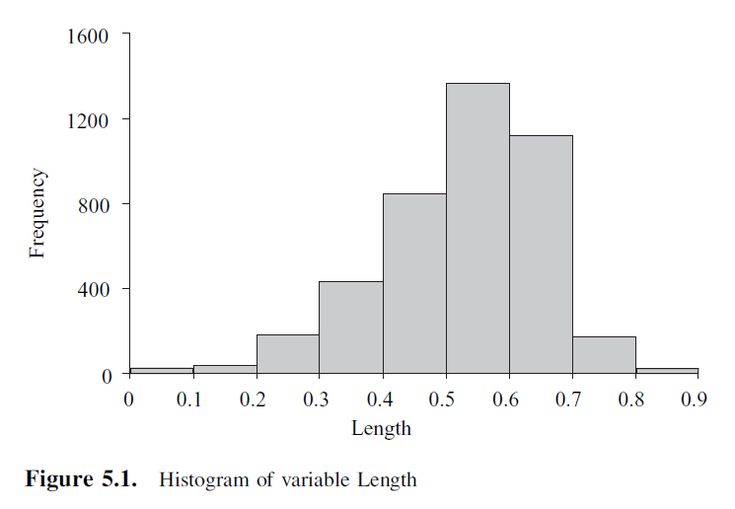
Descriptive Statistics
Descriptive statistics describe variables in a number of ways. It also allow us to quantify precisely these descriptions of the data.
Joseph Marvin R. Imperial
QUANTITATIVE METHODS
NU College of Computing and Information Technologies
Course Code: CCQUAMET

Slide 3
Central Tendency
In addition to describing the shape of the distribution of a sample or population of measurements, we also describe the data set’s central tendency.
A measure of central tendency represents the center or middle of the data. Sometimes we think of a measure of central tendency as a typical value.
Mean
Mode
Median
Joseph Marvin R. Imperial
QUANTITATIVE METHODS
NU College of Computing and Information Technologies
Course Code: CCQUAMET

Slide 4
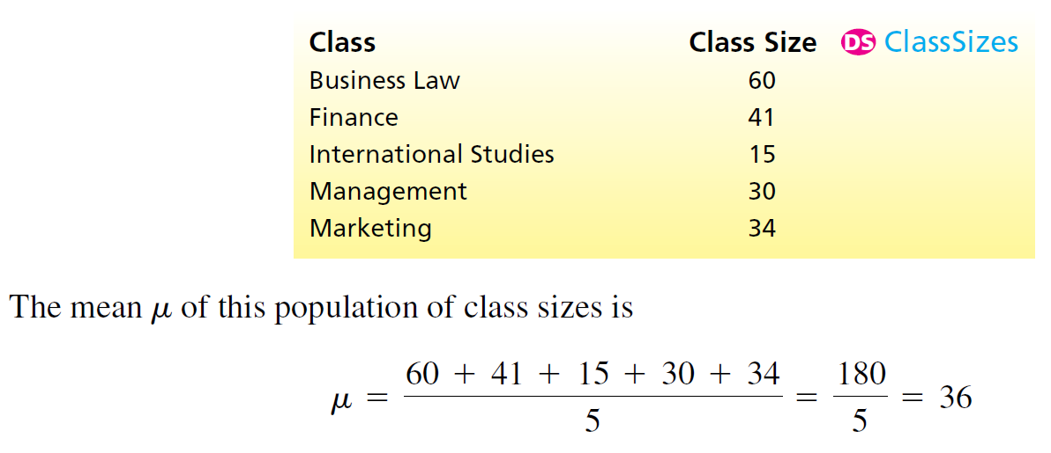
Population Mean
One important measure of central tendency for a population of measurements is the population mean.
The population mean, which is denoted 𝜇 and pronounced mew, is the average of the population measurements.
Joseph Marvin R. Imperial
QUANTITATIVE METHODS
NU College of Computing and Information Technologies
Course Code: CCQUAMET

Slide 5
Population Parameters
In order to understand how to estimate a population mean, we must realize that the population mean is a population parameter.
A population parameter is a number calculated using the population measurements that describes some aspect of the population. That is, a population parameter is a descriptive measure of the population.
Joseph Marvin R. Imperial
QUANTITATIVE METHODS
NU College of Computing and Information Technologies
Course Code: CCQUAMET

Slide 6
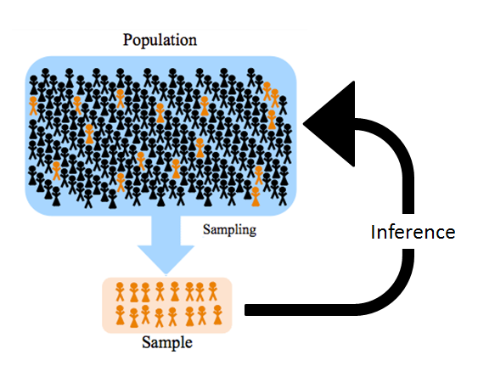
Estimating Population Parameters
The simplest way to estimate a population parameter is to make a point estimate, which is a one-number estimate of the value of the population parameter.
It should it should be an educated guess based on sample data.
One sensible way to find a point estimate of a population parameter is to use a sample statistic.
Joseph Marvin R. Imperial
QUANTITATIVE METHODS
NU College of Computing and Information Technologies
Course Code: CCQUAMET

Slide 7
Sample Statistic
A sample statistic is a number calculated using the sample measurements that describes some aspect of the sample. That is, a sample statistic is a descriptive measure of the sample.
Joseph Marvin R. Imperial
QUANTITATIVE METHODS
NU College of Computing and Information Technologies
Course Code: CCQUAMET

Slide 8
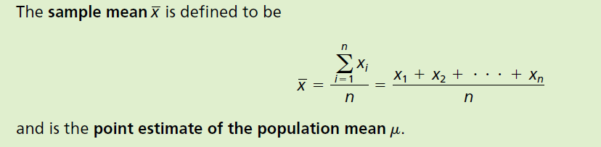

Sample Mean
The sample statistic that we use to estimate the population mean is the sample mean, which is denoted as $\overline{x}$(pronounced x bar) and is the average of the sample measurements.
Joseph Marvin R. Imperial
QUANTITATIVE METHODS
NU College of Computing and Information Technologies
Course Code: CCQUAMET

Slide 9
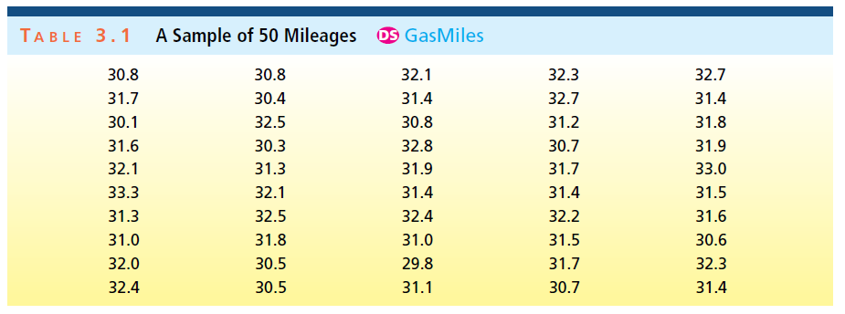
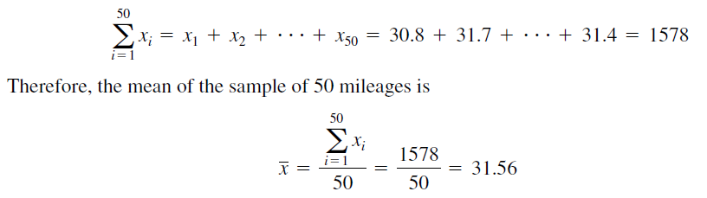
Example: sample mean
This point estimate says we estimate that the mean mileage that would be obtained by all of the new midsize cars that will or could potentially be produced this year is 31.56 mpg. Unless we are extremely lucky, however, there will be sampling error.
That is, the point estimate 31.56 mpg,
which is the average of the sample of fifty randomly selected mileages, will probably not exactly equal the population mean 𝜇, which is the average mileage that would be obtained by all cars.
Joseph Marvin R. Imperial
QUANTITATIVE METHODS
NU College of Computing and Information Technologies
Course Code: CCQUAMET

Slide 10
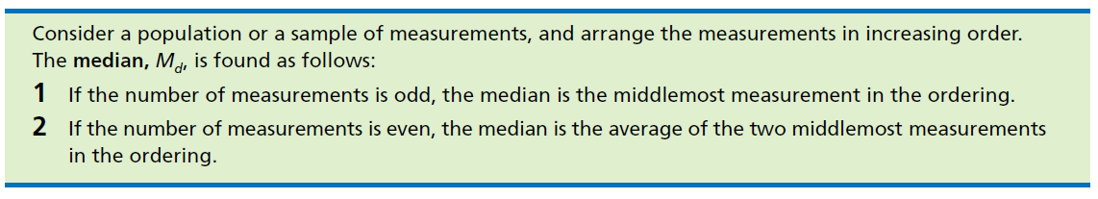
Sample Median
Intuitively, the median divides a population or sample into two roughly equal parts.
Joseph Marvin R. Imperial
QUANTITATIVE METHODS
NU College of Computing and Information Technologies
Course Code: CCQUAMET

Slide 11
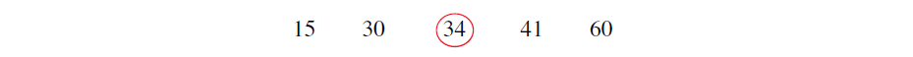
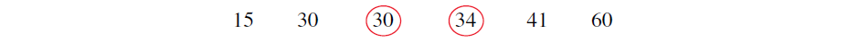
Example: sample median
For example, recall that Chris’s five classes have sizes 60, 41, 15, 30, and 34. To find the median
of the population of class sizes, we arrange the class sizes in increasing order as follows:
As another example, suppose that in the middle of the semester Chris decides to take an additional
class—a sprint class in individual exercise. If the individual exercise class has 30 students,
then the sizes of Chris’s six classes are (arranged in increasing order):
Because the number of classes is even, the median of the population of class sizes is the average of the two middlemost class sizes, which are circled. Therefore, the median is students (30 + 34)/2 = 32.
Note that, although two of Chris’s classes have the same size, 30 students, each observation
is listed separately (that is, 30 is listed twice) when we arrange the observations in increasing order.
Joseph Marvin R. Imperial
QUANTITATIVE METHODS
NU College of Computing and Information Technologies
Course Code: CCQUAMET

Slide 12
Sample Mode
A third measure of the central tendency of a population or sample is the mode.
Joseph Marvin R. Imperial
QUANTITATIVE METHODS
NU College of Computing and Information Technologies
Course Code: CCQUAMET

Slide 13
Example: sample mode
For example, the mode of Chris’s six class sizes is 30. This is because more classes (two) have a size of 30 than any other size.
Sometimes the highest frequency occurs at more than one measurement. When this happens, two or more modes exist. When exactly two modes exist, we say the data are bimodal and may be reported as {first mode, second mode} or (first mode + second mode)/2.
When more than two modes exist, we say the data are multimodal.
If data are presented in classes (such as in a frequency or percent histogram), the class having the highest frequency or percent is called the modal class.
Joseph Marvin R. Imperial
QUANTITATIVE METHODS
NU College of Computing and Information Technologies
Course Code: CCQUAMET

Slide 14
Activity: 5-10 mins
Try finding the mean, mode, and median with any dataset you have using formulas from Google Sheets / Excel.
By now, you can already do this.
Joseph Marvin R. Imperial
QUANTITATIVE METHODS
NU College of Computing and Information Technologies
Course Code: CCQUAMET

Slide 15
Comparing the mean, median, and mode
Often we construct a histogram for a sample to make inferences about the shape of the sampled population.
When we do this, it can be useful to smooth out the histogram and use the resulting relative frequency curve to describe the shape of the population. Relative frequency curves can have many shapes. Three common shapes are illustrated below:
Joseph Marvin R. Imperial
QUANTITATIVE METHODS
NU College of Computing and Information Technologies
Course Code: CCQUAMET

Slide 16
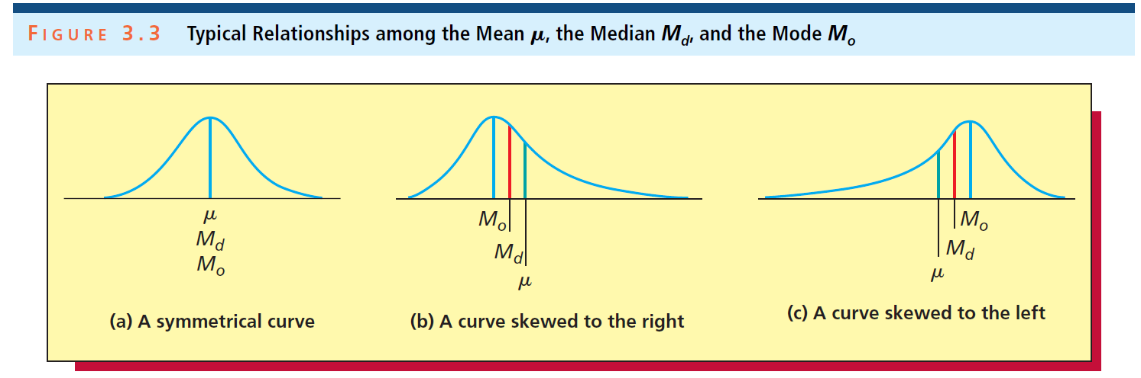
Part (a) - of this figure depicts a population described by a symmetrical relative frequency curve. For such a population, the mean (𝜇), median (M_{d}), and mode (M_{o}) are all equal. Note that in this case all three of these quantities are located under the highest point of the curve. It follows that when the frequency distribution of a sample of measurements is approximately symmetrical, then the sample mean, median, and mode will be nearly the same.
Part (b) - depicts a population that is skewed to the right. Here the population mean is larger than the population median, and the population median is larger than the population mode
Part (c) - depicts a population that is skewed to the left. Here the population mean is smaller than the population median, and the population median is smaller than the population mode.
Joseph Marvin R. Imperial
QUANTITATIVE METHODS
NU College of Computing and Information Technologies
Course Code: CCQUAMET

Slide 17
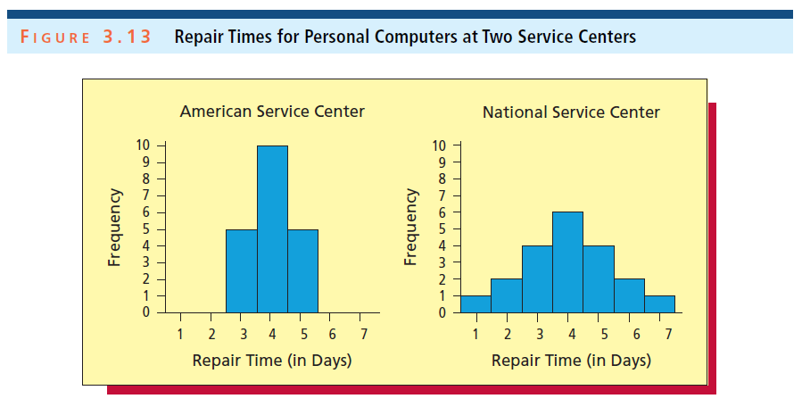
Variation
In addition to estimating a population’s central tendency, it is important to estimate the variation of the population’s individual values.
Joseph Marvin R. Imperial
QUANTITATIVE METHODS
NU College of Computing and Information Technologies
Course Code: CCQUAMET

Slide 18
Case study: variation of repair times
Each portrays the distribution of 20 repair times (in days) for personal computers at a major service center. Because the mean (and median and mode) of each distribution equals four days, the measures of central tendency do not indicate any difference between the American and National Service Centers.
However, the repair times for the American Service Center are clustered quite closely together, whereas the repair times for the National Service Center are spread farther apart (the repair time might be as little as one day, but could also be as long as seven days).
Therefore, we need measures of variation to express how the two distributions differ.
Joseph Marvin R. Imperial
QUANTITATIVE METHODS
NU College of Computing and Information Technologies
Course Code: CCQUAMET

Slide 19
Range
One way to measure the variation of a set of measurements is to calculate the range.
In Figure 3.13, the smallest and largest repair times for the American Service Center are three days and five days; therefore, the range is 5 - 3 = 2 days.
On the other hand, the range for the National Service Center is 7 - 1 = 6 days. The National Service Center’s larger range indicates that this service center’s repair times exhibit more variation.
Joseph Marvin R. Imperial
QUANTITATIVE METHODS
NU College of Computing and Information Technologies
Course Code: CCQUAMET

Slide 20
Range
In general, the range is not the best measure of a data set’s variation.
In general, to fully describe a population’s variation, it is useful to estimate intervals that contain different percentages (for example, 70 percent, 95 percent, or almost 100 percent) of the individual population values.
Joseph Marvin R. Imperial
QUANTITATIVE METHODS
NU College of Computing and Information Technologies
Course Code: CCQUAMET

Slide 21
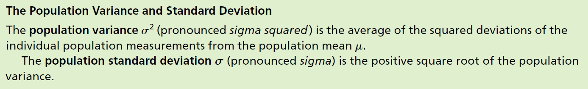
Population Variance and STDev
Joseph Marvin R. Imperial
QUANTITATIVE METHODS
NU College of Computing and Information Technologies
Course Code: CCQUAMET

Slide 22
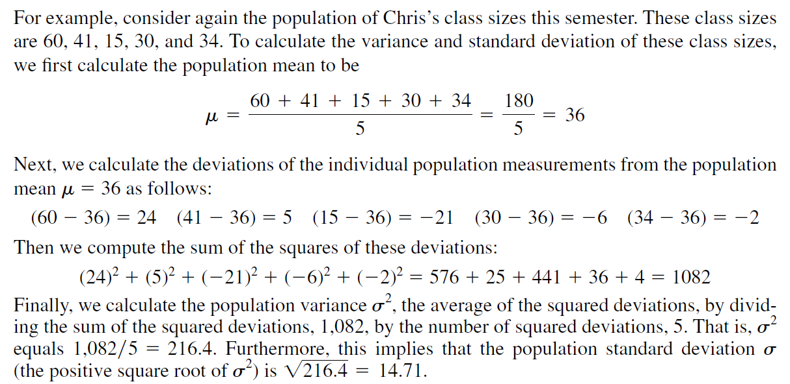
Case study: Chris’ class
Joseph Marvin R. Imperial
QUANTITATIVE METHODS
NU College of Computing and Information Technologies
Course Code: CCQUAMET

Slide 23
Population Variance and STDev
The more spread out the population measurements, the larger is the population variance, and the larger is the population standard deviation. And vice versa.
When a population is too large to measure all the population units, we estimate the population variance and the population standard deviation by the sample variance and the sample standard deviation.
Joseph Marvin R. Imperial
QUANTITATIVE METHODS
NU College of Computing and Information Technologies
Course Code: CCQUAMET

Slide 24
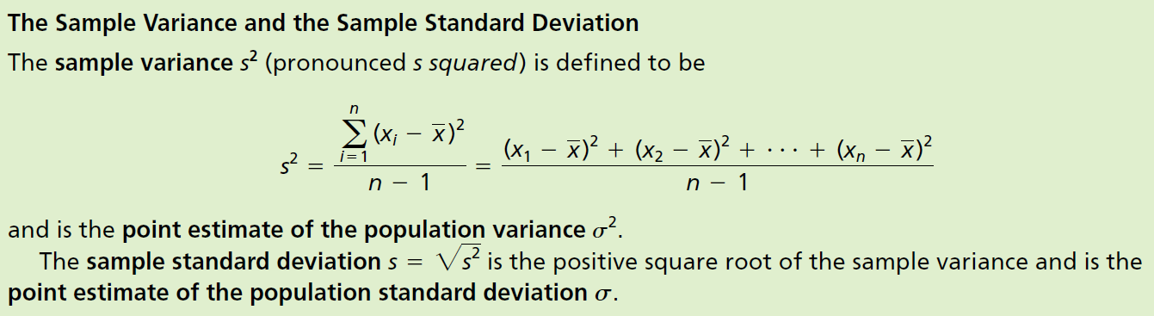
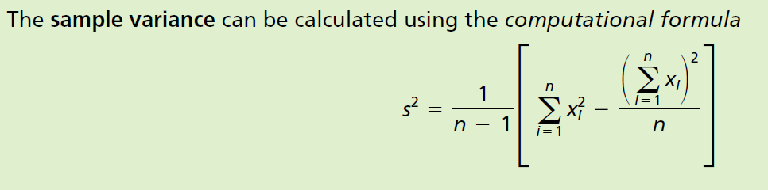
Sample Variance and STDev
Joseph Marvin R. Imperial
QUANTITATIVE METHODS
NU College of Computing and Information Technologies
Course Code: CCQUAMET

Slide 25
Variance vs Standard Deviation
Standard deviation looks at how spread out a group of numbers is from the mean, by looking at the square root of the variance.
The variance measures the average degree to which each point differs from the mean—the average of all data points.
Since, standard deviation is the square root of variance, the value is in the same units as the mean.
A normal distribution with mean = 10 and sd = 12 is exactly the same as a normal distribution with mean = 10 and variance = 144.
Joseph Marvin R. Imperial
QUANTITATIVE METHODS
NU College of Computing and Information Technologies
Course Code: CCQUAMET

Slide 26
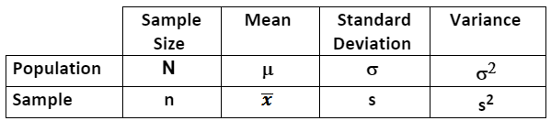
Notations
Joseph Marvin R. Imperial
QUANTITATIVE METHODS
NU College of Computing and Information Technologies
Course Code: CCQUAMET

Slide 27
Activity: 5-10 mins
Try finding the standard deviation and variance with any dataset you have using formulas from Google Sheets / Excel manually and automatically.
By now, you can already do this.
Joseph Marvin R. Imperial
QUANTITATIVE METHODS
NU College of Computing and Information Technologies
Course Code: CCQUAMET

Slide 28
The Normal Distribution
A normal distribution has a bell-shaped density curve described by its mean and standard deviation . The density curve is symmetrical, centered about its mean, with its spread determined by its standard deviation.
Joseph Marvin R. Imperial
QUANTITATIVE METHODS
NU College of Computing and Information Technologies
Course Code: CCQUAMET

Slide 29
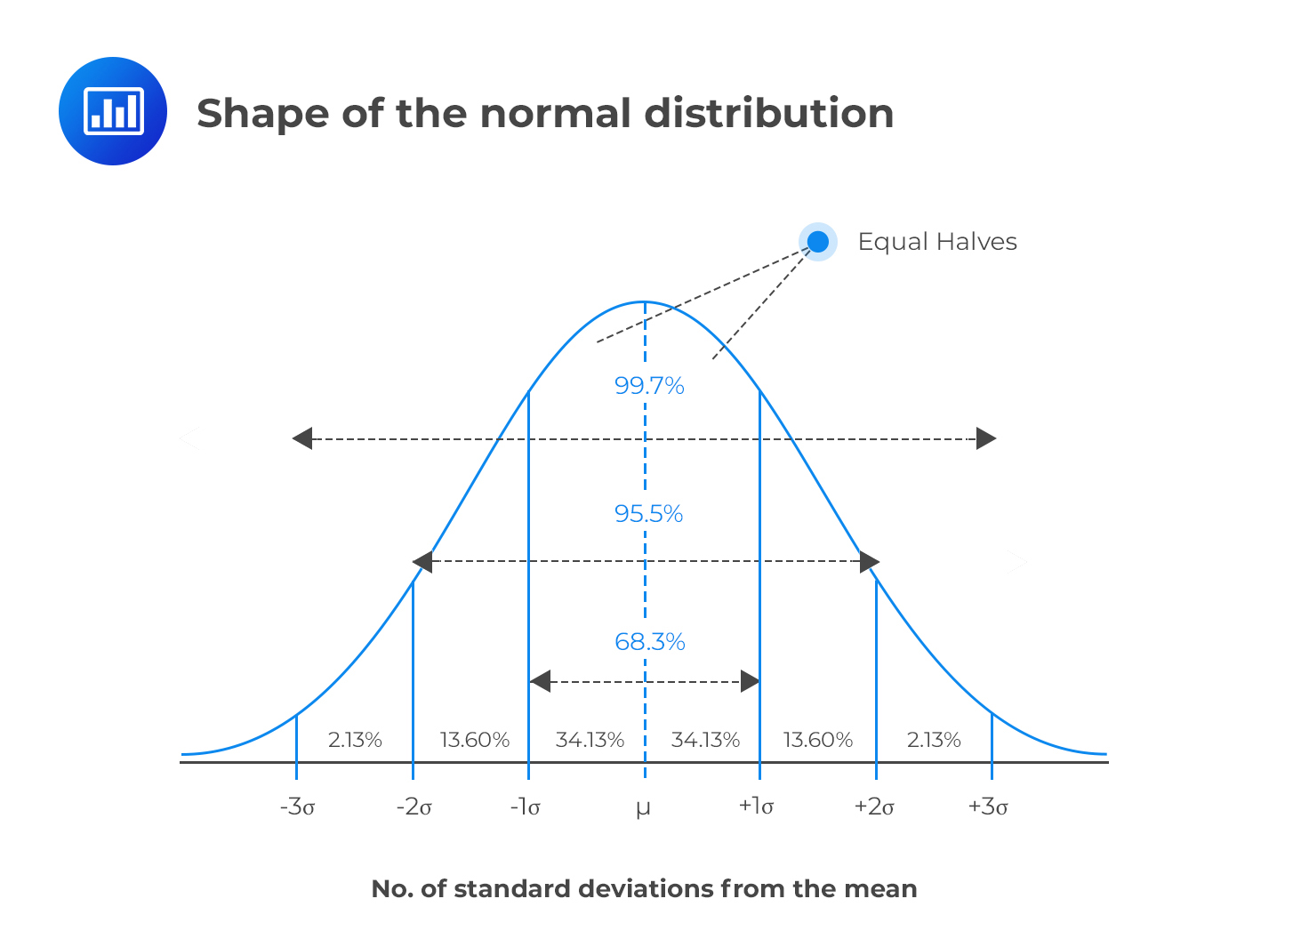
Joseph Marvin R. Imperial
QUANTITATIVE METHODS
NU College of Computing and Information Technologies
Course Code: CCQUAMET

Slide 30
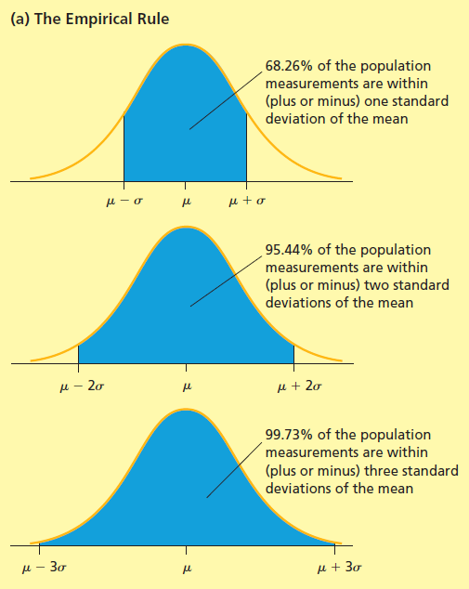
Empirical Rule
One type of relative frequency curve describing a population is the normal curve.
The normal curve is a symmetrical, bell-shaped curve and is illustrated on the right.
If a population is described by a normal curve, we say that the population is normally distributed.
Joseph Marvin R. Imperial
QUANTITATIVE METHODS
NU College of Computing and Information Technologies
Course Code: CCQUAMET

Slide 31
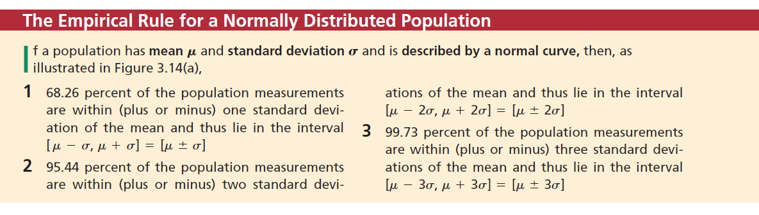
Empirical Rule
Joseph Marvin R. Imperial
QUANTITATIVE METHODS
NU College of Computing and Information Technologies
Course Code: CCQUAMET

Slide 32
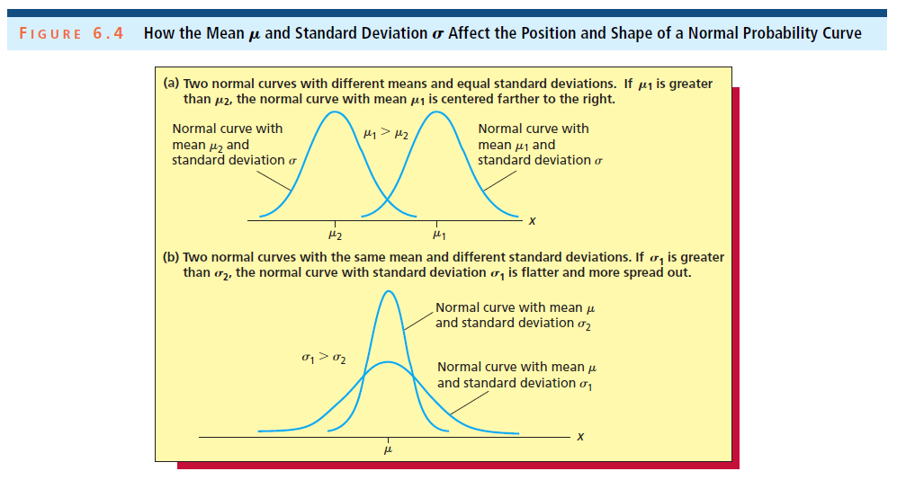
The Normal Distribution
Joseph Marvin R. Imperial
QUANTITATIVE METHODS
NU College of Computing and Information Technologies
Course Code: CCQUAMET

Slide 33
Activity: 5-10 mins
Plotting a normal curve in Google Sheets using formulas.
Joseph Marvin R. Imperial
QUANTITATIVE METHODS
NU College of Computing and Information Technologies
Course Code: CCQUAMET

